Slide 1
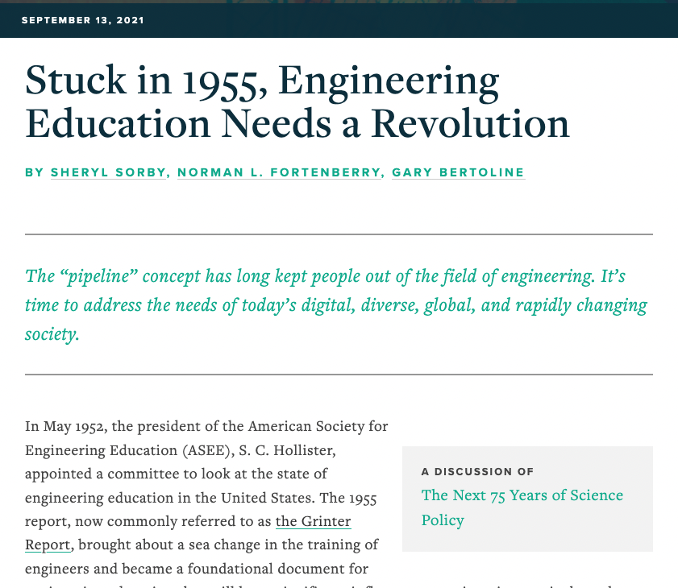
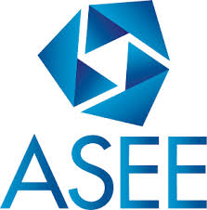
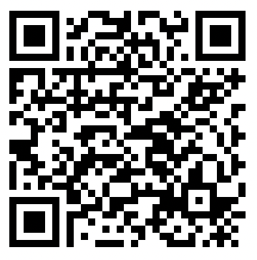
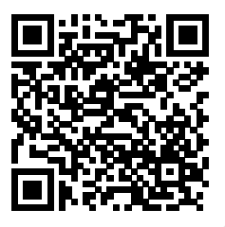
“We are at a crossroads in engineering education, where we can either continue to incrementally improve a system handed to us by our past, or create a movement to design a new system that addresses the challenges we face now and into the future.”

